Slide 1
Climate Change project update: week 5
Rens Breunissen,
Lotte van Dongen,
Markus Peschl,
Cecilia Casolo,
Maaike Elgersma,
Eva Slingerland,
Simon van Oosterom
Supervised by
Lorinc Meszaros [Deltares]
Robbert Fokkink [TU Delft]
Mathematical Data Science

Slide 2
Github
We used a Github drive in order to share codes and results. You can join the drive and view our progress with the following link:
https://github.com/Deltares-Climate-Change/Deltares-Climate-Change

Slide 3
This week we worked on:
Finishing the research on clustering and Neural Networks
Writing the report

Slide 4
Clustering
We finished a verification measure for the number of clusters
We Generated the clusters for all different models, stations, and scenarios
Finally, we combined this with the code that analyzes the changes between the early and late years

Slide 5
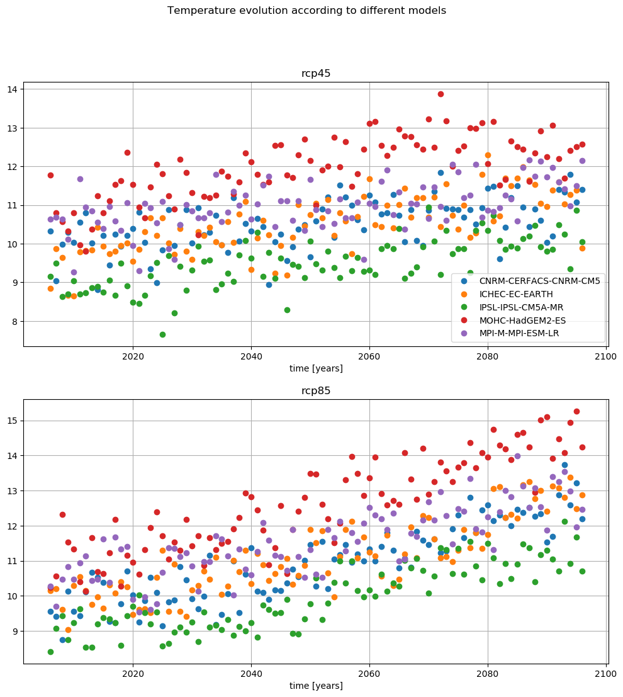
Analyzing the clusters
Figure from the pre-analysis
As an example we can compare two models with the two different scenarios.
Here, one can see that the MOHC predicts an extreme rise in temperature while CNRM is more or less the average of the models, so we can compare those

Slide 6
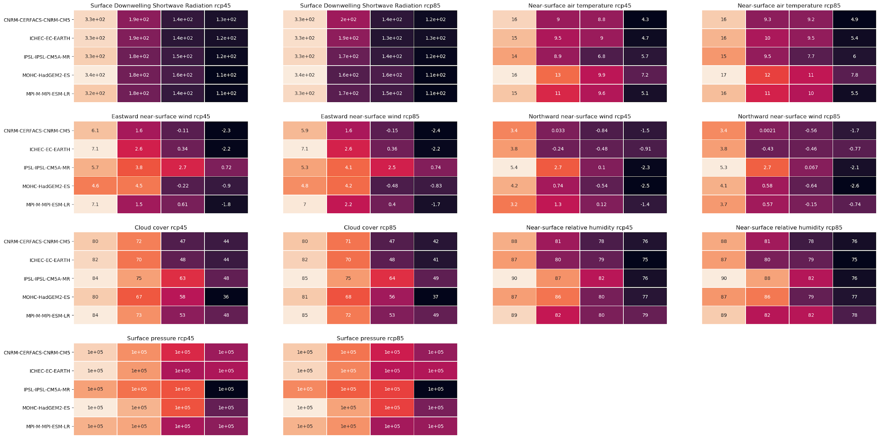
Analyzing the clusters for all models at the same time
Cluster 1
Cluster 3
Cluster 2
Cluster 4
In order to analyze and compare the different clusters, we created the following chart (zooming in may be required).
It shows the average values for all variables for all models and all scenarios when we group into 4 clusters for station Marsdiep.

Slide 7
Analyzing the clusters for all models at the same time
In order to analyze and compare the different clusters, we created the following chart (zooming in may be required).
It shows the average values for all variables for all models and all scenarios when we group into 4 clusters for station Marsdiep.
One can see that the MOHC model is different from the other models w.r.t. temperature and the IPSL in most of the other variables

Slide 8
Clustering final remarks
To Do:
Look at the KNMI/IPCC/Cordex reports in order to find nice ways of vizualizing the data
Expand the validation of the clusters
Combine the code for comparing the first and last 10 years and the code for analyzing the clusters.
Possibly ignore one (or more) variables in order to generate other clusters
Implement spatial clustering on the original dataset (when there is time left)

Slide 9
Prediction
Currently we have two prediction scenarios:
Predicting a variable from other variables (in a fixed model/station setting)
Predicting all variables of one model from all variables of a different model

Slide 10
Model Prediction: The Deep Learning Approach
For predicting models, we took the Deep learning approach. Let’s call the input model X and the output model Y. We have two different networks set up:
A linearly connected network predicting variables for each day separately. The input is a vector of variables of model X for a specific day and the goal is to output the corresponding vector of variables of model Y for the same day
A sequence to sequence network, consisting of two Long Short Term Memories (LSTMs) stacked together with a final linearly connected layer. The input is a sequence of vectors of model X (e.g. 30 days) and the desired ouput is a sequence of vectors for model Y corresponding to the same dates.

Slide 11
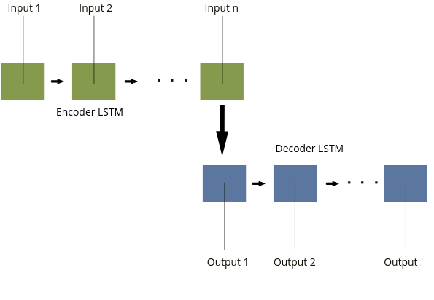
Model Prediction: The Deep Learning Approach
Here is a small sketch of the Seq2seq architecture:

Slide 12
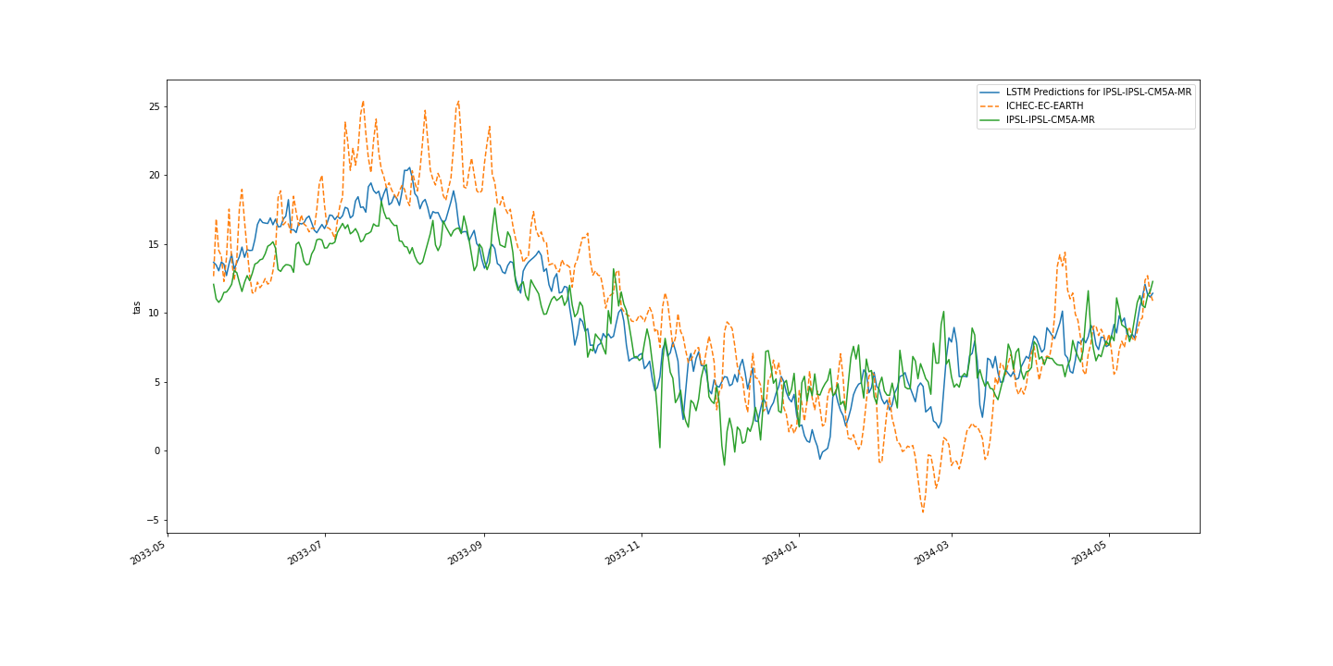
Model Prediction: The Deep Learning Approach
As expected, the LSTMs outperform the linearly connected networks. While the latter does on average converge to a reasonable solution, the per day outputs are highly noisy and do not represent the ground truth. On the other hand, the LSTM does capture the desired sequences fairly well, especially if it is tested on years that are not too far away from the training set. For example, let’s look at predictions of temperature for one of the first years in the test set. Here the input was IHEC-EC-EARTH and the labels from IPSL-IPSL-CM5A-MR

